Slide 1
What has Malala Yousafzai been passionately advocating?
a) The right to education for all girls
b) The right to healthcare
c) The right to clean water

Slide 2
Malala Yousafzai
Girls were banned from being in education in the country
Malala believed girls should have the right to an education
Since 2012, Malala has been speaking out publicly about this

Slide 3
What career did Rudyard Kipling pursue?
a) Actor
b) Author
c) Musician

Slide 4
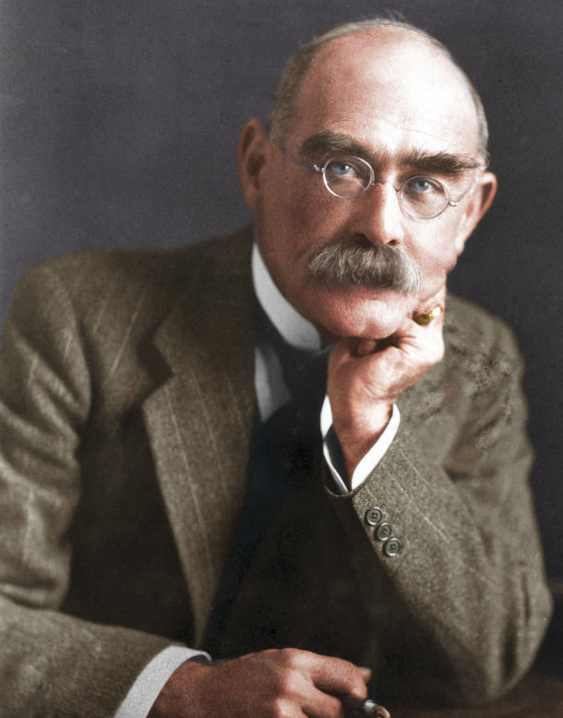
Rudyard Kipling
Fired from him role at the San Francisco Examiner
An editor told him:
‘he didn’t know how to use the English language’
Went on to author over 20 books

Slide 5
What is Walt Disney famous for being?
a) A business man
b) An engineer
c) An animator & film producer

Slide 6
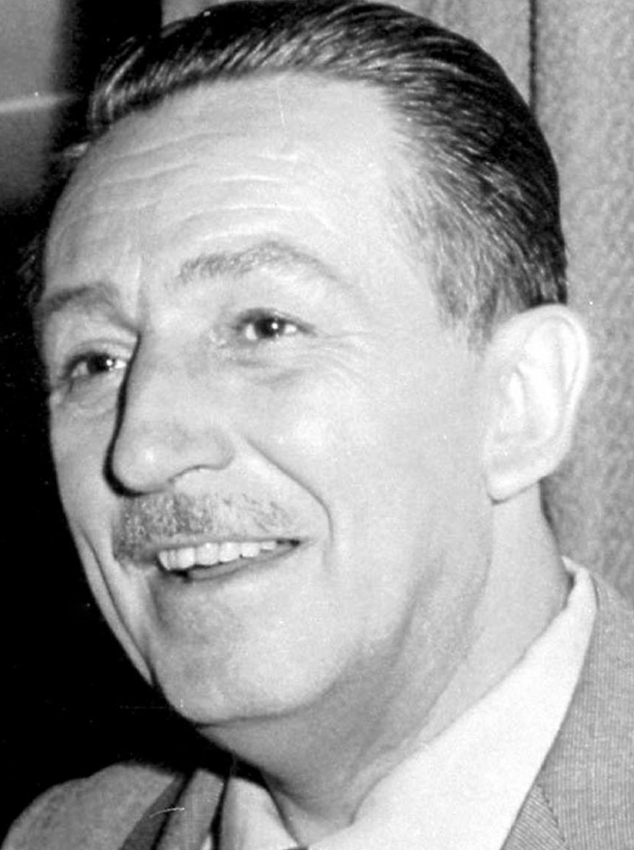
Walt Disney
Record number of academy awards; 22 Oscars from 59 nominations
Fired from the Kansas City Star
An editor said he ‘lacked imagination and had no good ideas’

Slide 7
What did Thomas Edison create in his lifetime?
a) The Phonograph
b) The Lightbulb
c) The Electrographic Vote Recorder

Slide 8
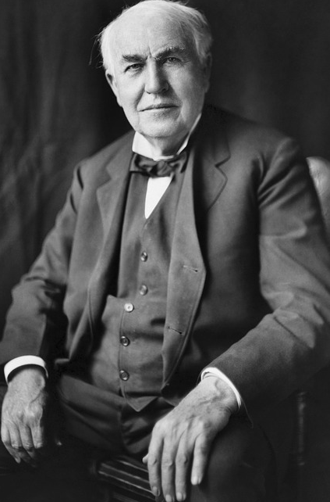
Thomas Edison
Worked at Western Union, where he secretly conducted science experiments
Got fired, after the acid burning through the floor during an experiment
Went on to be one of the best known inventors

Slide 9
What theory is Albert Einstein famous for formulating?
a) Theory of Gravity
b) Theory of Evolution
c) Theory of Relativity

Slide 10
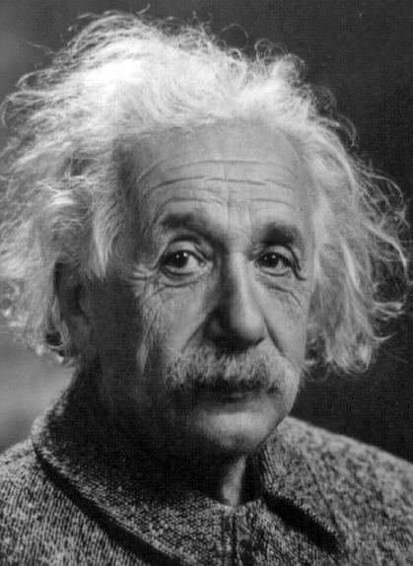
Albert Einstein
Einstein didn’t speak a word until he was 4
His primary school teacher accused him of being lazy because of his abstract questions
Went on to formulate a theory that answers lots of science’s questions

Slide 11
Kingfisher House, 109a West Wycombe Road, High Wycombe, Bucks, HP12 3AB
T 01494 522777 E office@wycombeyfc.org.uk W www.wycombeyfc.org.uk
Charity No. 1063771. A member of British Youth For Christ

